Slide 1
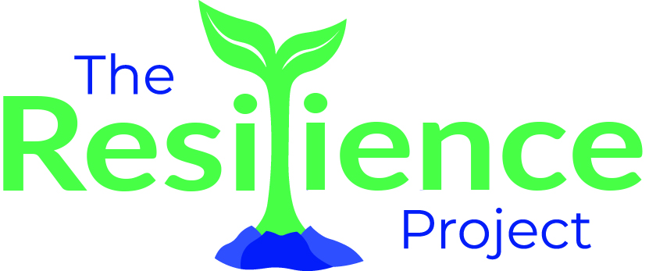
June 2024 Update Meeting
Partners:
Adventure 4 Change
African Family Revival Organization
Bridges to Belonging
Canadian Aweil Youth Association
Canadian Arab Women’s Association*
Canadian Somali Association
Eritrean Islamic Association
Keskese Milash KW*
Family and Children’s Services
House of Friendship
Hummingbird Centre for Hope
Kitchener Waterloo Art Gallery
Levant
Muslim Social Services
Spectrum*
Women’s Crisis Services
Funded by:
Lyle S Hallman
Fairmount Foundation
KWCF
United Way
Foundation of Family & Children’s Services of Waterloo Region
Amplifying Capacity by Moving Forward Together
Action Groups, Workplan, and Evaluation Efforts

Slide 2
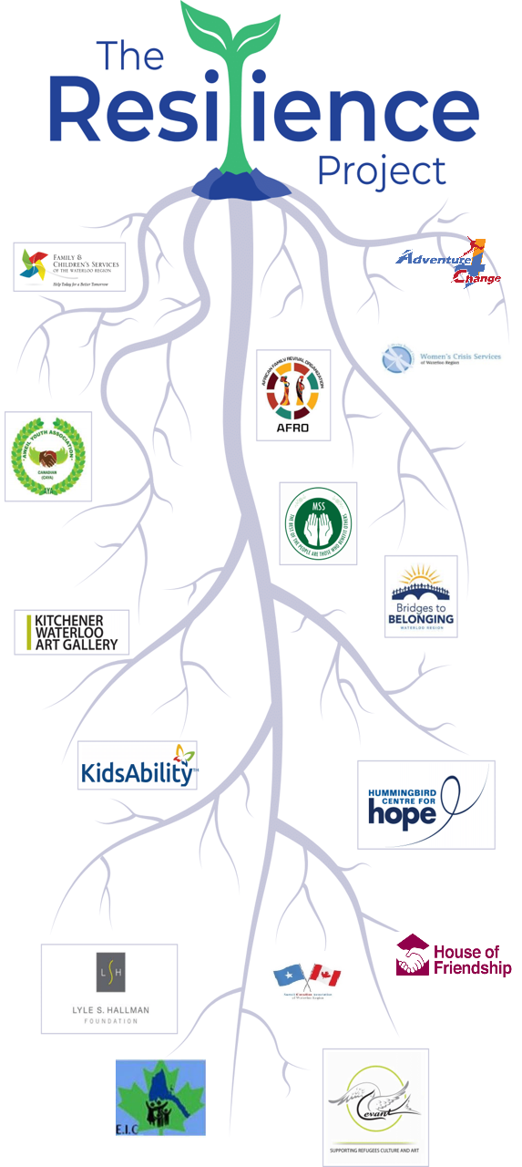
The Resilience Project
Vision
To prevent child abuse and neglect from occurring, escalating, or reoccurring by creating a supportive and resilient community environment where children, youth, and families can thrive.
Objectives
This initiative focuses on children and youth along the prevention continuum—those at risk of or already involved with the child welfare system.

Slide 3
Key Goals for Resilience Project:
Address
Address Interconnected Root Causes
Foster
Foster Empowerment and Systemic Change
Strengthen
Strengthen Collaborative Community Actions
Establish
Establish Shared Governance and Transparent Accountability
Cultivate
Cultivate Resilient Youth
Promote
Promote Identity and Community Connection
Enhance
Enhance Program Delivery and Safety
Sustain
Sustain Engagement and Learning

Slide 4
Backbone Responsibilities
Project Management
Oversee the overall progress of all action groups.
Ensure timely execution of planned activities.
Schedule and facilitate regular drop-in sessions for facilitators.
Facilitators want to set up an informal drop-in through virtual means.
Financial Management
Monitor budget and funding allocations.
Facilitate financial workshops and capacity-building sessions.
Collaborate for corporate sponsorships and grants.
Evaluation
Track and measure the impact of initiatives.
Compile feedback and make adjustments as needed.
Evaluate changes in knowledge, attitudes, and short-term behaviour among participants.
Assess the sustained impact on community resilience, such as improved social support networks and reduced community-level stressors.
Communication
Develop and implement a communication/social media plan.
Promote events and activities through various channels.
Manage external communication and updates about the Resilience Project.

Slide 5
Strategic Partnerships: Enhancing Impact through Collaboration
Overview of Resilience Partners
A diverse coalition of stakeholders and organizations.
Collaborate to pool resources, expertise, and community connections.
Involved in program delivery, strategic planning, and evaluation.
Approaches to Partnership
Grassroots Approach: Focus on community-led initiatives and local stakeholder engagement.
Goal - Enhance partners’ visibility in public engagement and recognition.
Mainstream Approach: Align with established protocols and integrate with larger systems.
Goal – leverage mainstream systems/collaboration tables to support our collective community resilience efforts.

Slide 6
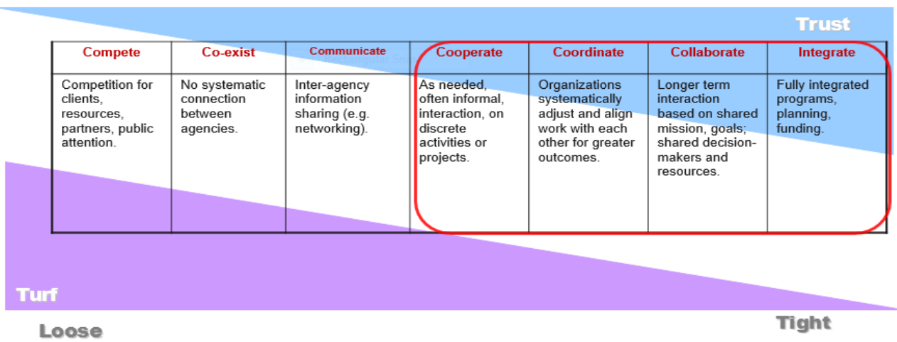
Strategic Partnerships: Continuum of Collaboration
January 2023 Discussion Recap
We reflected on our starting point and shared our initial thoughts.
Where do you see yourself today?
Do you feel the project has progressed?
If yes, how?
here are the gaps?
Notes:
In January 2023 – we had this discussion – we had our own thoughts of where we were – where do you see yourself today? Do you see the project having moved? If yes how? If not where?

Slide 7
Shared Governance Responsibilities
Partners Level and Youth Level
Voting Memberships
Partners Level: Include key stakeholders and decision-makers from community organizations and government agencies.
Youth Level: Engage youth representatives to provide direct input and vote on relevant issues.
Budget Allocation Priorities
Partners Level: Discussion on major funding priorities and strategic allocations.
Youth Level: Empower youth to allocate a portion of the budget for projects important to their demographic.
Overarching Work Plan and Action Items
Partners Level: Develop a comprehensive work plan focusing on long-term goals and strategic initiatives.
Youth Level: Create a parallel youth-focused action plan that aligns with the overarching goals but addresses specific youth interests and needs.
Family Events
Both Levels: Organize family-inclusive events that encourage participation from all members of the community, fostering a sense of belonging and engagement.

Slide 8
Resilience project workplan 2024-2028

Slide 9
2024-2028 overarching workplan Timeline
2024 – Establishment and Initial Actions
2025 – Community Engagement and Expansion
2026 – Scaling and Strengthening
2027 – Final Evaluations and Planning
2028 – Long Term Impact and Scaling

Slide 10
2024: focusing on the foundation
Establish Governance Structure,
Partner's website
Drop-ins for facilitators
Theory of Change and Evaluation Methods Update
Establish Training Schedule and begin training
Begin Monthly Community-Based Meetings
Establish Action Groups and Facilitators’ Network
Launch Communication Initiatives
Internal newsletter
Partner’s newsletter
RP overarching Fall 2024

Slide 11
2025: Community Engagement and Expansion
Continue Community Engagement: Maintain active program delivery and community interactions.
Conduct Evaluations regularly to assess and adjust program impacts.
Expand Funding Opportunities: Explore new sources and organize capacity-building workshops.
Increase Visibility and Awareness: Enhance communication efforts.

Slide 12
2026: Scaling and strengthening
Expand Programs: Scale up successful pilot programs to include more demographics.
Conduct the First Resilience Summit: Engage stakeholders, share findings, collect feedback.
Strengthen Partner Capacity based on evaluations.
Continuous Evaluation to assess impact.
Compile and Share Success Stories.
Plan for Sustainability of successful initiatives.

Slide 13
2027: Final Evaluation and planning
Action Groups: Continue workplan implementation and evaluation.
Final Evaluations and Reporting: Complete assessments, including Social return on investment.
Develop Sustainability Plans with partners and funders.

Slide 14
2028: Long-Term impact and scaling
Review of Action Groups and Priority Setting.
Second Resilience Summit: Present results, share strategies, discuss long-term sustainability.
Scaling Up Successful Initiatives to reach broader demographics and integrate more services.

Slide 15
Action groups update

Slide 16
Building Collective Community Resilience Through Working Together
Action Groups
Objective: Enhance systemic equity and efficiency.
Key Actions: Organize community meetings, identify and address systemic barriers, and implement improvement strategies.
Belonging: "Addressing Isolation"
Objective: Foster community connections and inclusivity.
Key Actions: Establish community programs, ensure cultural relevance, and coordinate with partners for inclusive event planning.
Sustainability and Capacity Building
Objective: Build sustainable funding and organizational capacity.
Key Actions: Conduct workshops on financial management and grant writing, and pursue funding opportunities.
Access to Resources
Objective: Improve access to culturally appropriate resources.
Key Actions: Facilitate resource access, update resource materials, and promote community awareness.
Systems Improvement: "Broken Systems"

Slide 17
Action Group 1: Systems Improvement (Fixing Broken Systems)
Leads: Leyco, Michelle, Jill (Backup)
Partners Involved: Trish, Scott, Sara, Marny, Daniel Zeri, etc.
Progress to Date: This group has been focused on identifying and addressing systemic barriers to housing and employment, particularly for vulnerable populations.
Activities include leveraging connections at various housing advocacy groups and planning to connect with political figures to address housing for low-income communities.
The group has utilized surveys to understand better systemic issues, particularly around housing shortages and discrimination.
Next Steps:
Strengthening partnerships with key housing advocacy groups and stakeholders
Survey analysis and report development of systemic barriers identified by Resilience Project Partners.

Slide 18
Action Group 2: Belonging (Addressing Isolation)
Leads: Jada & Liz
Partners Involved: Duaa, Sara, Adel, etc.
Progress to Date: Focused on establishing community programs to enhance social connections among seniors, youth, and newcomers. They've coordinated events and activities that promote interaction and have been working on identifying gaps in community services, such as the need for more support for adults and seniors. This group has also highlighted the importance of integrating services like lawn care and grocery shopping to assist with housing instability
Next Steps: Expand the program to fill the identified underserved demographics and gaps; leverage existing partnerships in programming, evaluation, and volunteer engagement.

Slide 19
Action group 3: Access to Resources (Removing Barriers)
Leads: Victor & Leyco (Backup)
Partners Involved: Duaa, Sara, Daniel, Scott, Adel, Marny, Trish, etc.
Progress to Date: The group is working to improve access to culturally appropriate resources. They've discussed the importance of having a centralized platform for identity-affirming and culturally sensitive resources. Efforts have been made to connect with various organizations to ensure a comprehensive and accessible client resource network. They are exploring the creation of a centralized resource list that all workers and organizations can access
Next steps: community outreach, centralized resource leveraging/development, and stakeholder meetings to access resources needed.

Slide 20
Action Group 4: Sustainability and Capacity Building
Leads: Jill, Michelle, Jada (Backup)
Partners Involved: Scott, Marny, Daniel, Zeri, Adel, etc.
Progress to Date: This group's efforts have been geared towards building partner organizations' financial sustainability and capacity building.
They have created a calendar of workshops on grant writing and , financial management, and capacity building are planning further training sessions.

Slide 21
Training Topic | Goal | Provided By | Timing
Truth and Reconciliation | Education and Understanding | FACS | Year 1
SOGIE Awareness | Education and Understanding | Spectrum; Rainbow Diversity Training 301 | Year 1
First Aid | Safety | Red Cross/St. John Ambulance | Year 2
Psychological First Aid | Safety and Wellbeing | Red Cross/CAMH/Dr.Mcleod | Year 1
Drug Awareness | Safety | House of Friendship? | Year 2
Trauma and Attachment | Education and Understanding (focused on those who work with children/youth/caregivers) | FACS | Year 2
Resilience 101 | Promoting Resilience and Understanding | FACS | All Members
Community Development | Capacity Building, focus on Collaboration | Home (paulborn.ca) | Year 2
Equity 101 (available for free) | Education, Understanding, and Awareness | Canadian Centre for Diversity and Inclusion, Salem Debs | Year 1
Child Abuse & Neglect | Safety and Education | FACS | Year 1
Duty to Report Child Abuse & Neglect | Safety and Education | FACS | Year 1
Youth Engagement | Meaningful Engagement for this Demographic | YouthRex (York University), KYAC (Kitchener Youth Action Council) | Year 2
Organizational Capacity Building (series) | Solid Leadership Structure, Capacity to Source Funding, Build Collaboration | Free Training from NonprofitReady.org | Year 2

Slide 22
Evaluation framework 2024-2028

Slide 23
Key Goals for Resilience Project:
Address
Address Interconnected Root Causes
Foster
Foster Empowerment and Systemic Change
Strengthen
Strengthen Collaborative Community Actions
Establish
Establish Shared Governance and Transparent Accountability
Cultivate
Cultivate Resilient Youth
Promote
Promote Identity and Community Connection
Enhance
Enhance Program Delivery and Safety
Sustain
Sustain Engagement and Learning

Slide 24
Key Goal 1: Addressing Interconnected Root Causes
Objective: Target complex factors contributing to child maltreatment and neglect.
Activities: Resilience training for all members, specific topic training, and an action group for capacity building.
Outcomes: Completion of resilience training by all partners and establishment of a sustainable collective. Identifying barriers through system navigation project.
Measurement:
Completion Rates: Track the completion of training sessions.
Action Group Effectiveness: Evaluate the action group’s impact on addressing root causes through annual reports and stakeholder feedback.

Slide 25
Key Goal 2: Foster Empowerment and Systemic Change
Objective: Empower communities to openly address and tackle resilience and equity barriers.
Activities: Formation of a collective table, system navigators for referrals, and an action group for system improvement.
Outcomes: Formation of stakeholder collective, use of service volume data for advocacy, and targeted system improvements.
Measurement:
Stakeholder Engagement: Assess the regularity and impact of meetings.
System Navigator Data Use: Analyze how effectively data is being used for advocacy and system improvements.

Slide 26
Key Goal 3: Strengthen Collaborative Community Actions
Objective: Enhance partner collaboration to effectively leverage and coordinate resources.
Activities: Establish a collaborative action group, person-centric program evaluations, and network resource mapping.
Outcomes: Address significant and minor community issues annually through collective efforts.
Measurement:
Collaborative Impact: Analyze collaborative efforts through feedback and resource mapping studies; emergent learning, appreciative inquiry, and collaboration of continuum

Slide 27
Key Goal 4: Establish Shared Governance and Transparent Accountability
Objective: Develop clear governance and ensure accountability.
Activities: Establish a backbone structure and a governance framework defining roles.
Outcomes: Implementation of a governance framework and positive partnership feedback.
Measurement:
Governance Structure Effectiveness: Review the functionality and clarity of the governance structure through annual assessments.
Partner Feedback: Gather and analyze partner feedback on governance and project management.

Slide 28
Key Goal 5: Cultivate Child, Youth, and Family Resilience
Objective: Enhance children, youth, and families’ resilience by fostering opportunities for personal and community growth.
Activities: Participation and data integration in child welfare programs, needs assessment, and delivery of youth, children, and families programming. Action Group Access to Resources.
Outcomes: Enhanced resilience in children, youth, and Families,
Measurement:
Program Outcomes: Evaluate the effectiveness of youth programs through participant feedback and pre/post assessments.
Needs Assessment Results: Review the alignment of programs with the identified needs of the youth, children, and families.
Youth in Care Outcomes: Monitor specific indicators related to youth in care to assess changes post-intervention.

Slide 29
Key Goal 6: Promote Identity and Community Connection
Objective: Enable youth to develop a strong sense of identity and community connection.
Activities: Establish youth decision-making avenues, deliver programming focused on activism, volunteerism, and leadership.
Outcomes: Active youth participation in decision-making, youth-led program evaluations.
Measurement:
Youth Decision-Making Impact: Assess the effectiveness of youth involvement in decision-making through feedback and participation rates.
Program Engagement: Measure the level of engagement and satisfaction among youth participants in community connection programs.

Slide 30
Key Goal 7: Enhance Program Delivery and Safety
Objective: Ensure that program delivery spaces are safe and supportive, focusing on trauma-informed practices.
Activities: Implement trauma-informed programs, create safe and welcoming environments, establish an action group focused on addressing isolation.
Outcomes: Accessible programs for all participants, addressing significant and minor issues related to isolation annually.
Measurement:
Program Safety Audits: Conduct regular safety audits to ensure programs are trauma-informed and secure.
Action Group Effectiveness: Review the impact of the action group’s initiatives on reducing isolation through community feedback and participation metrics.

Slide 31
Key Goal 8: Sustain Engagement and Learning
Objective: Use continuous learning and feedback mechanisms to adapt and improve project strategies dynamically.
Activities: Develop strategies for continuous stakeholder involvement, ensure the project remains responsive to community needs. Every 2 years Resilience Summits/Retreats.
Outcomes: Consistent partner feedback on planning and adaptation to new challenges.
Measurement:
Stakeholder Involvement: Measure the extent of stakeholder engagement and its influence on project outcomes.
Resilience Summit/Retreat: Impact of learning.

Slide 32
Thank you!

